Slide 1
Travel Management System
Presentation By:
Amir Maharjan & Saroj Maharjan

Slide 2
Table of Content
Chapter 1: Introduction
Chapter 2: Background study and Literature review
Chapter 3: System Analysis and Design
Chapter 4: Implementation and Testing
Chapter 5: Conclusion
References

Slide 3
Chapter 1: Introduction 1.1 Introduction Of Project
The process of planning, booking and managing travel arrangements can be both complex and time consuming.
It is in response to this challenge that we propose the development of a comprehensive “Travel Management System” that will plan, book and manage all travel arrangements with a single click of a button.
While also exploring new travel destinations listed in the website.

Slide 4
1.2 Problem Statement
Users cannot find best and affordable trips.
They would have to manually visit the office.
Cannot keep track of the users while in trip.

Slide 5
1.3 Objectives
Create a system that helps to choose the best and affordable trip.
View images of the destinations.
New Travelers can read reviews from previous travelers.

Slide 6
1.4 Scope And Limitation
Scope
People with minimum knowledge about website can also use this website.
Can become a community for travelers.
User-friendly interface for booking.
Limitation
Relies on internet connectivity for real-time tracking and updates.
Initial implementation and training may require time and resources.

Slide 7
Chapter 2: Background Study And Literature Review 2.1 Background Study
Tripadvisor is one of the best travel websites out there. It provides reviews and evaluation of other people on destinations, trips, housing, etc. The major drawbacks are the bad UI design and the website looks like a blog website more than a travel website.
During the research phase of the project, we came across many websites that we could take as references. Daraz, a well-established e-commerce business was one of them. It’s a great platform to buy products from. It is constantly giving out discount coupons and amazing offers. We can also order products as a guest. But the biggest drawback of it, is that the UI is not very good and is very hard to navigate throughout the system.

Slide 8
2.2 Literature Review
In Daraz, system was developed by Daraz Group and is the most used e-commerce business in Nepal. The most astonishing feature of Daraz is that it lets the user buy products without actually logging into the system. The users can buy products as a guest. Order placement feature is also equally impressive.
In Nepal Everest Base Camp & Nepal Trekking Experts, system was developed by Nepal Everest Base Camp Trekking Company and Nepal Trekking Experts Pvt Ltd. Both of them showcase the best itinerary. Itinerary is a travel document recording a route or journey. It is very much similar to our own system. It has kept its itinerary simple and straight to point so that anyone can understand the journey.

Slide 9
Chapter 3: System Analysis And Design 3.1 System Analysis
"System analysis" is the process of breaking down a system to improve it using better procedures and techniques. This process involves planning a new system to either improve or replace an existing system. Thus, it is the process of gathering and analyzing data, recognizing problems, and applying the data to provide feedback on system modifications.
When conducting a system analysis, the following objectives are kept in mind:
Perform economic and technical analysis.
Assign responsibilities to the database, hardware, software, and other parts of the system.

Slide 10
3.1.1 Requirement Analysis
To ascertain the requirements and expectations of a new product, a technique known as requirements analysis or requirements engineering is utilized.
It entails regular communication with the product's stakeholders and end users to clarify expectations, settle disputes, and record all essential requirements.

Slide 11
3.1.1.1 Functional Requirement
Functional requirements are requirement that make up our entire website. For example: a registration form, when a user fills it, the data that is submitted has to be stored in the database in a secure manner.
The system provides the following functionalities:
Add to favorites
User request to cancel their booking
Detailed pricing and plans of trips

Slide 12
3.1.1.2 Non-Functional Requirement
Reliability
Security
Availability
Performance

Slide 13
3.1.2 Feasibility Analysis
Technical
Operational
Economic
Schedule

Slide 14
3.1.3 Data-Modeling (ER Diagram)
A data model is a mechanism that provides abstraction for database application. Data models define how data is connected to each other and how they are processed and stored in a system. ER (Entity Relationship) diagram is a database structure that show the relationship between entity and their attributes connect with each other via primary key and foreign key.

Slide 16
3.1.4 Process Modeling (DFD)
Data Flow Diagram (DFD) is a graphical representation of how the data flows in the proposed or an already existing system.
The DFD is also known as context diagram or bubble chart.
Its main purpose is to help understand how the data flows in the system.

Slide 17
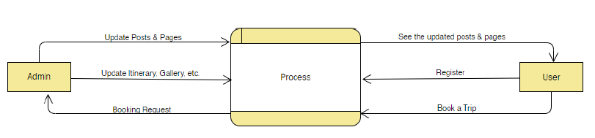
DFD level 0 is a graphical representation of the system without much detail. It just gives a basic overview of how the data flows in the proposed or an already existing system. Below is a DFD level 0 figure:

Slide 18
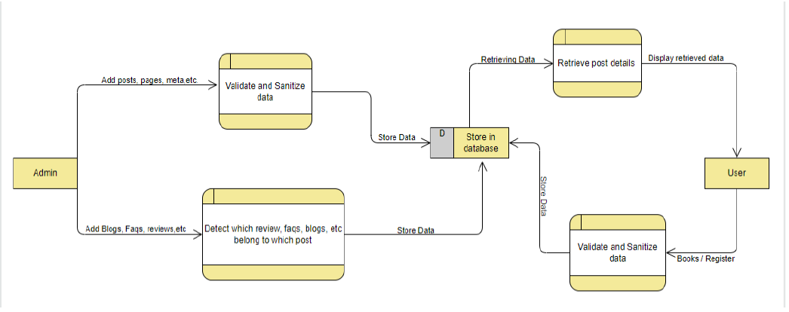
DFD level 1 is another graphical representation of the system that has more detail of how the data flows in the system. It has more details than the DFD level 0. A DFD level 1 is given below: T

Slide 19
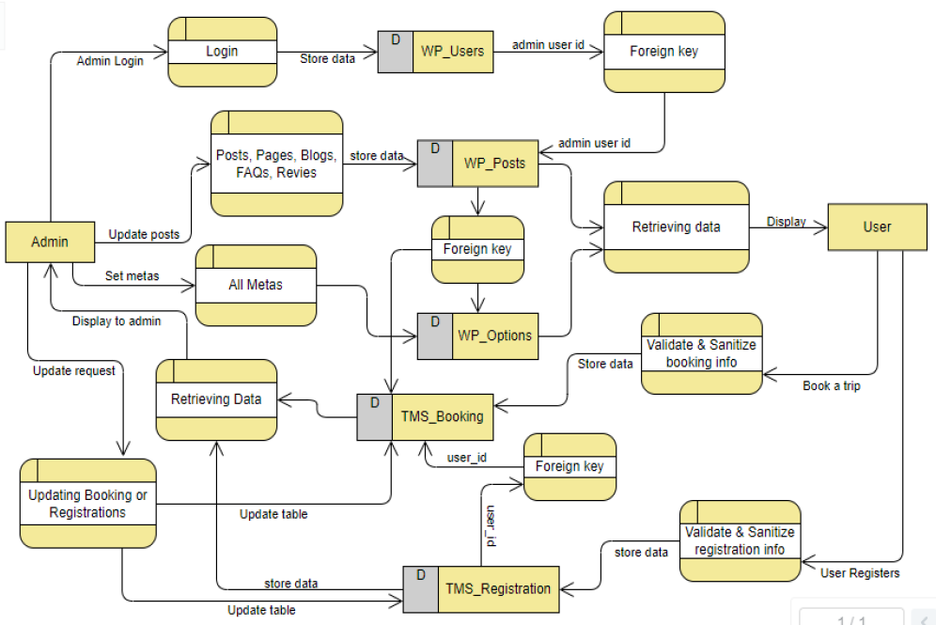
DFD level 3 has the more details of how the data flows in the system than any other level. It tries to display as much detail of data flows as possible. A figure of DFD level 3 is given below:

Slide 20
3.2 System Design
The process of meeting the end-user requirements by designing the architecture, components and interfaces for the system is called system design.
The system must be designed in such a way that it meets all of the end-user’s requirements.

Slide 21
3.2.1 Architectural Design
The purpose of this phase is to design how the users will see the system, how the system deals with user inputs and how the data gets stored in the database. All these things are planned and carried out in detail without missing out on anyone of these things.
Presentation login: how the users will see the system.
Business logic: how the user’s inputs will be handled.
Database driver: how the user’s inputs are stored in the database.

Slide 22
3.2.2 Database Schema Design
According to dictionaries, schemas are a representation of a plan or theory in the form of an outline or model.
Database schema is the skeleton structure that represents the logical view of the entire database.
It shows the relationship between different tables and its attributes.
Two tables are linked with each other by the use of primary key and foreign key.
It is designed by database designers.

Slide 23
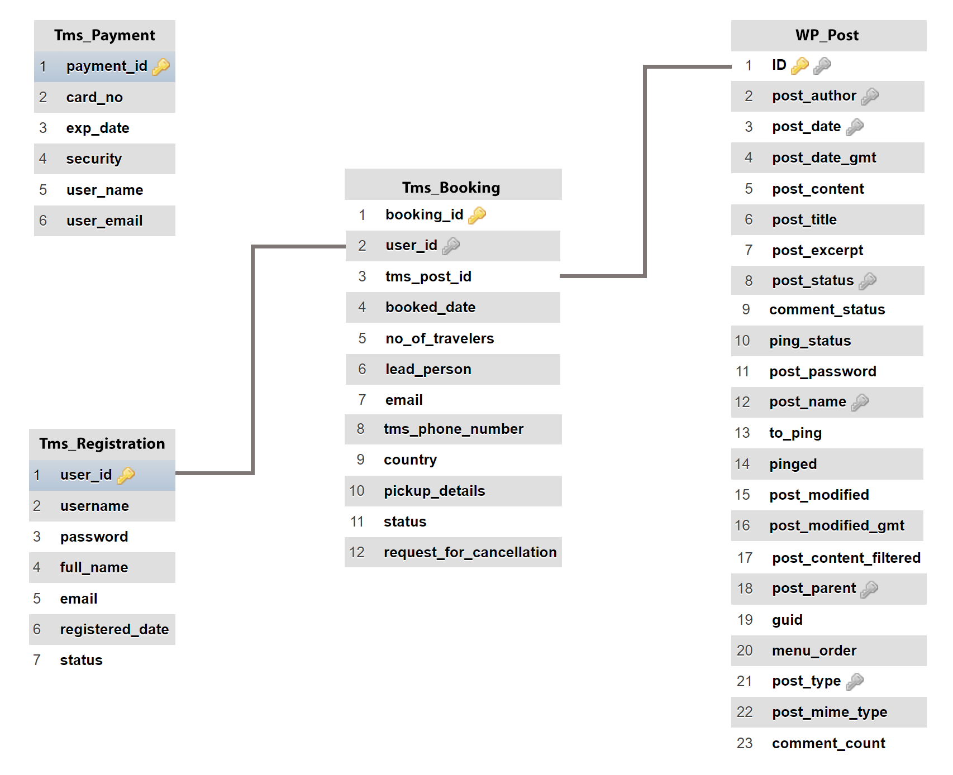

Slide 24
3.2.3 Interface Design (UI interface / interface structure diagrams)
Photoshop and Adobe XD have been used in the design of the application's or system's UI.
Both are user-interface tools for producing, modifying, and working with raster and vector pictures.
The figures below represent some of the features of the system like theme mode, login system, registration system, review section, etc.

Slide 25
3.2.4 Physical DFD
Physical DFD is similar to logical DFDs.
The main difference between the two DFD types is physical DFD represents how the system is actually implemented where as the logical DFD represents a generic flow of data.

Slide 26
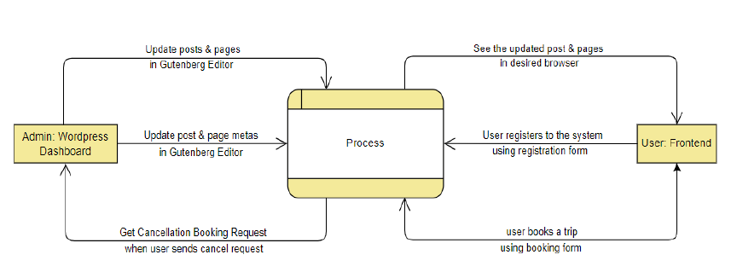
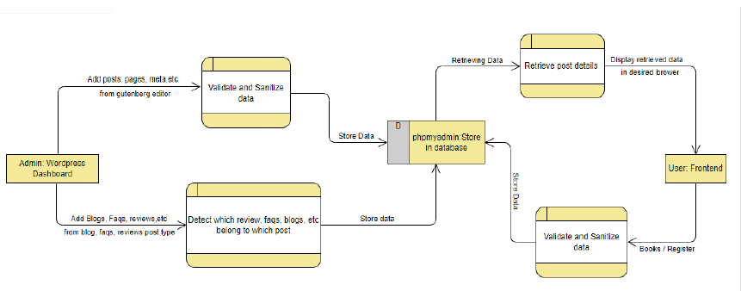

Slide 27
Chapter 4: Implementation & Testing 4.1 Implementation
Before collaborating with content writers and quality assurance specialists to produce thorough documentation, developers will conduct a final review of the newly implemented system.
This means that the development team can now begin getting ready for the product launch.
During the deployment phase, the software development team is ready to collect and evaluate user feedback in order to better understand how their product is functioning and how to improve it in order to boost customer satisfaction.

Slide 28
4.1.1 Tools used
CASE Tools
Draw.io
Lucidchart
Database Platforms
phpMyAdmin
Libraries Used
Slick Slider
jQuery Cookies
Magnific Popup
Programming Languages
Frontend
Html
Css
jQuery
Backend
PHP
AJAX

Slide 29
4.1.2 Implementation details of modules
Following the completion of the planning phase, we go on to the implementation phase, when the entire system is broken down into modules in order to reduce effort and find any new faults or issues.
The report cannot describe every element of the modules, but it will document the majority of them.
Among the modules are a few of these:

Slide 30
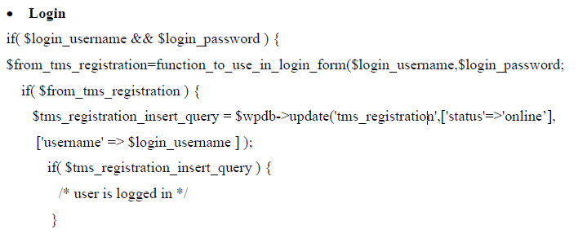
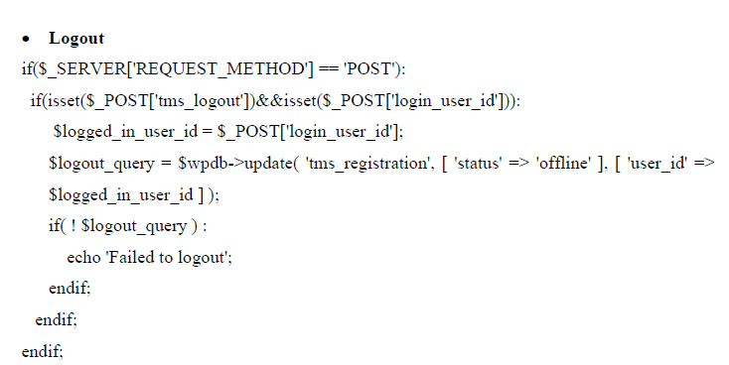

Slide 31
4.2 Testing
Now that the system has been designed, examined, and put into operation, it is time to test it for flaws and faults.
The testing step of the system development process is essential since it reduces errors and aids in system troubleshooting.
Although there are many various kinds of tests that can be done, for the sake of this report, we will mostly concentrate on the system's functionality, performance, and security.

Slide 32
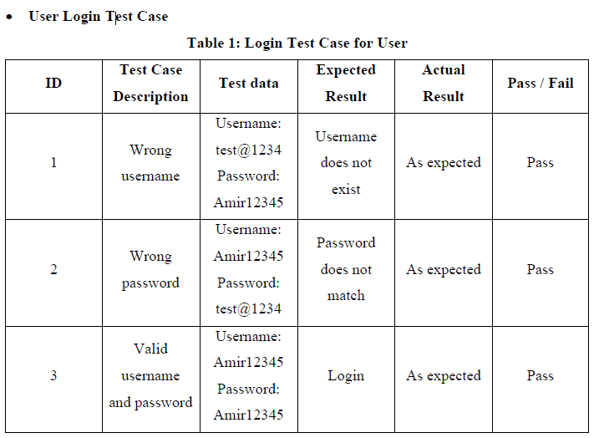

Slide 33
4.2.2 Test case for system testing
Verify that the username is greater or equal to 8 characters or more.
Verify that the password is stored in the database via md5 or password hashing.
Verify that phone numbers are 10 characters long or not and are numeric or not.
Verify that the emails are valid or not by filtering the emails
Verify that for better UI interface and user satisfaction, form fields contain dropdowns, radio buttons, checkboxes, sliders, etc.

Slide 34
Chapter 5: Conclusion & Future Recommendation 5.1 Lesson Learnt / Outcome
This project taught us many things on personal and professional level.
On personal level, we learned to work in a team and communicate better with each other.
On the professional side, we learned that there are many aspects to keep in consideration during the development of the project like accessibility (people with physical disability should also be able to use website), internationalization (website should be free of any language barriers), security, etc.

Slide 35
5.2 Conclusion
Our goal was to create a system that would enable users to plan trips whenever they wanted, from anywhere.
The users can view various tours and travels, read about them, view their FAQs and reviews, see their price information, etc.
These objectives have been met by the current application. We completely adhered to the requirements, but, when necessary, we extended some of the features.

Slide 36
5.3 Future Recommendation
Making WordPress custom widget and adding them to our website
Making use of WordPress customizer and making website even more dynamic
Making a WordPress plugin to enrich website with even more features.
Adding update user profile section
Adding change password section
Adding video playlist section

Slide 37
References
Daraz, "Daraz," [Online]. Available: https://www.daraz.com.np/.
N. E. B. C. T. Company, "Nepal Everest Base Camp," [Online]. Available: https://www.nepaleverestbasecamp.com/.
N. T. Experts, "Nepal Trekking Experts," [Online]. Available: https://nepaltrekkingexperts.com/.
T. LLC, "Tripadvisor," [Online]. Available: https://www.tripadvisor.com/.
S. Commerce, "Traveler," [Online]. Available: https://modmixmap.travelerwp.com/.
Navan, "Navan," [Online]. Available: https://navan.com/.

Slide 38
The end

